Slide 1
Fantasy Pokemon League Research & Needfinding
The Bird Wootchers

Slide 2
Market Research

Slide 3

Pokemon Showdown
Pros:
Cons:
Most comprehensive team builder
Supports full editing of all Pokemon stats
Supports battling
Has online chat room functionality
Not super intuitive
All data saved in the form of browser cookies
No type comparisons

Slide 4
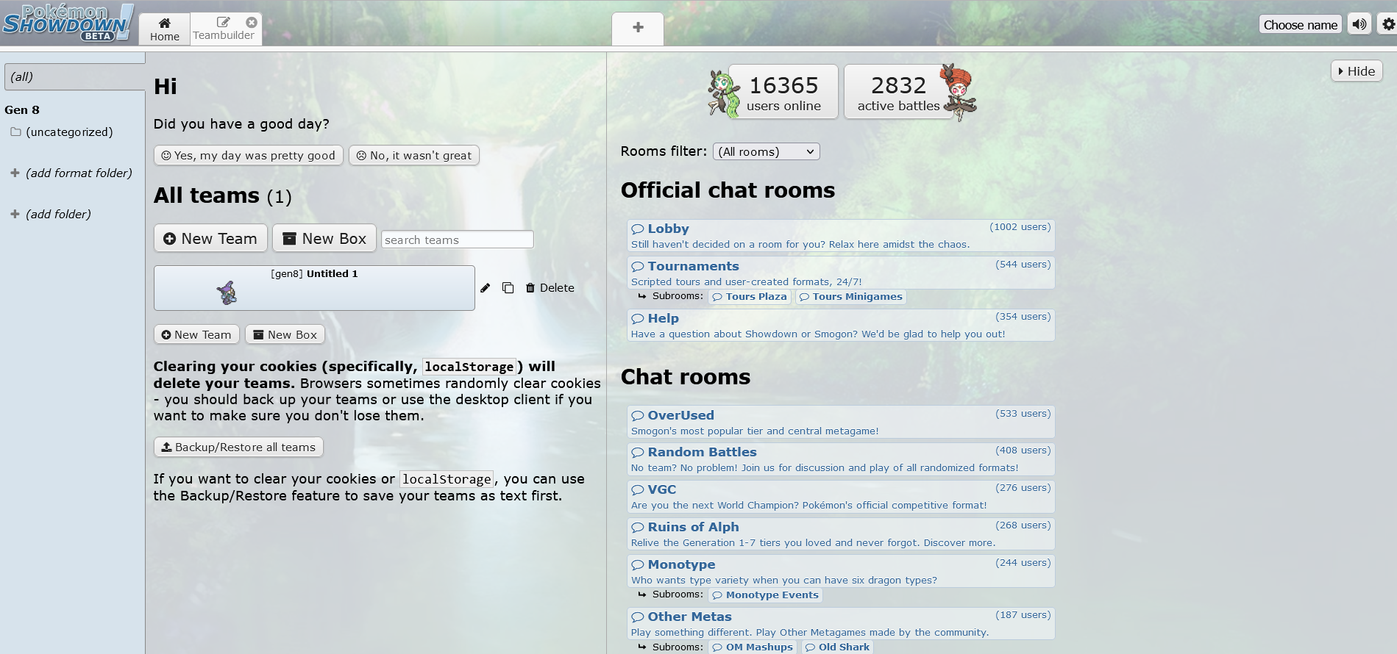

Slide 5
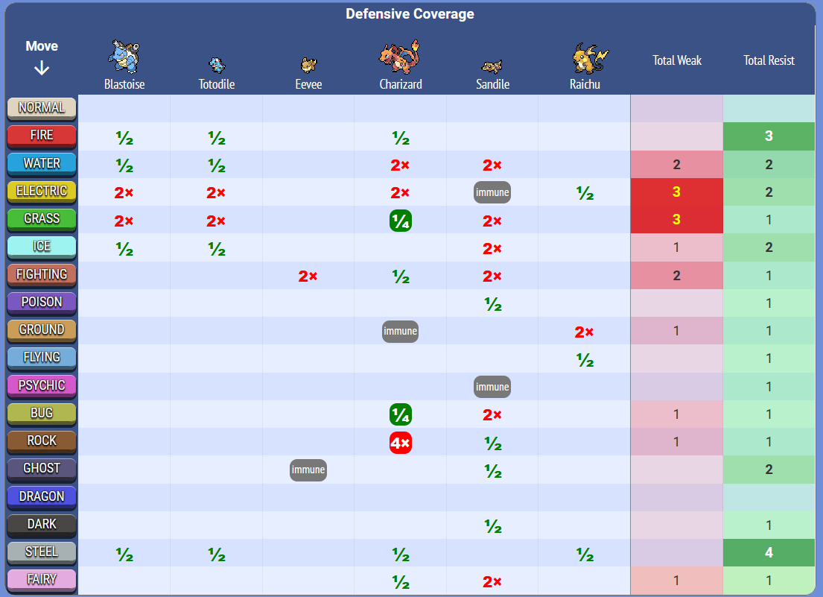
Marriland’s Pokemon Team Builder
Pros:
Team strengths/weaknesses easily viewable in dynamic chart
Simple and visually readable layout
Cons:
No support for moves
No social component
Layout of application awkward for focused team editing

Slide 6
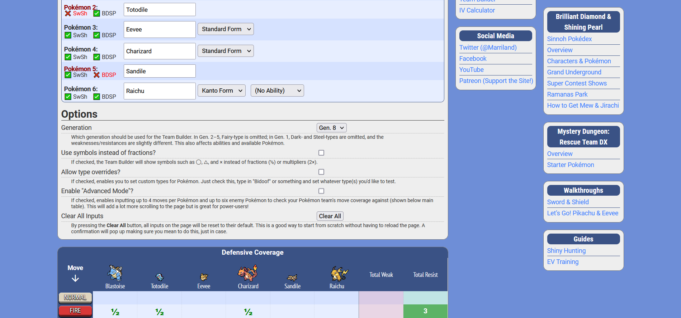

Slide 7
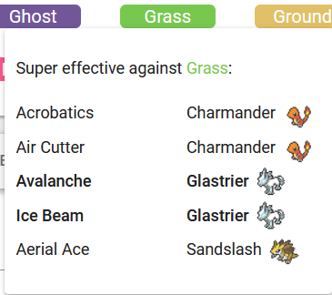
My Pokemon Team
Pros:
Cons:
Very compact, readable visual layout
Full move support
Dynamically generated strength/weakness tables
Information communicated intuitively
No social component
Does not list pokemon or move type
Strength / weakness calculation methods unclear

Slide 8
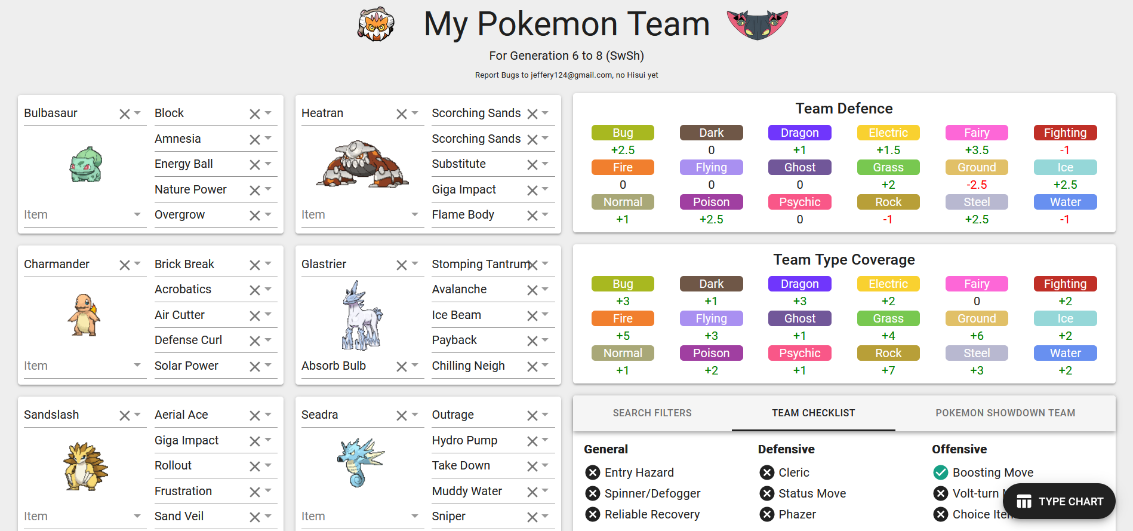

Slide 9
There is no team builder that . . . .
Supports comments on teams
Has dynamic type comparisons
Allows for creation of multiple teams
and
Fully supports movesets in its comparisons

Slide 10
Interviews

Slide 11
Interview Notes
Interviews were conducted with 3 separate people, 2 of which being more avid Pokemon fans, while person 3 was a much more casual fan of the game series.
None of the three have experience using external team building softwares for building Pokemon teams.
All three felt that the initial process of learning certain game mechanics was quite difficult, and a team planner that shows overall type advantages and disadvantages of a team would be beneficial

Slide 12
Major Findings
Two of the three interviewees felt that displaying stats would be necessary for a good team builder
All three of the interviewees often do not fully plan out a team initially. They may partially design a team and have a few slots open for random pokemon throughout their playthrough.
Our team builder should consider this fact, and have a way of showing how a team evolves and how the team synergies change over time.

